Slide 1
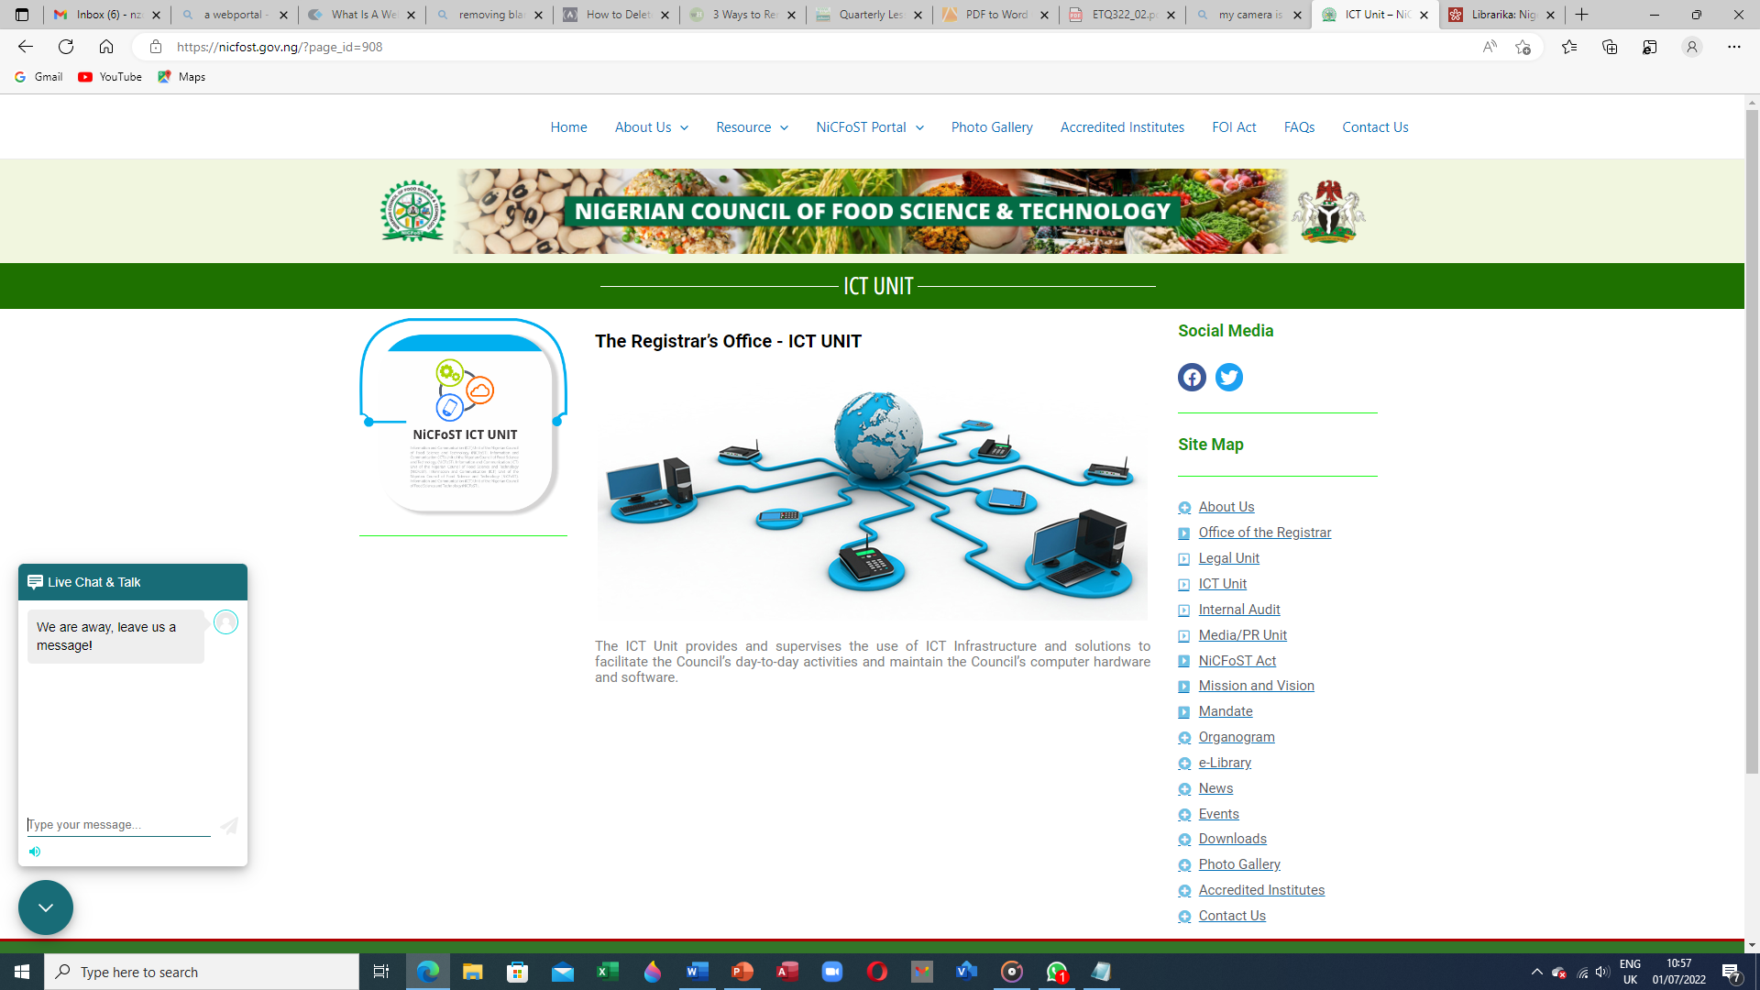
ICT Core Activities
Digitize Council's documented information
Manage and maintain the database of registered Food professionals and Business premises
Provide technical backstopping across Departments/Units
Establish Quality Control Framework for ICT infrastructure
Oversee the development, management and maintenance of Council’s information systems

Slide 2











ICT Unit Interactions With Other Departments/Units
Registrar’s Office
Admin and Human Resource Management Department
Finance and Accounts Department
Procurement Department
Legal Unit
Internal Audit Unit
Inspection and Monitoring Department
Food Science and Technology Practice Department
Registration and Licensing Department
Education and Training Department
Media/PR Unit
ICT Unit

Slide 3
Use of Computers and Computer Accessories
1.0 Introduction
Computer literacy has become an indispensable skill required of every employee at all levels of public and private engagement. Consequently, it is expected of every employee to have a certain amount of dexterity in the use of a personal computer and its accessories to function effectively and to deliver quality services in today's information economy. Those who do not have such skills may struggle to deliver consistently and optimally in their scheduled responsibilities.

Slide 4
2.0 Use of NiCFoST Computer Resources – What We Need to Know
While using NiCFoST computing devices, staff may not have absolute right of privacy as to any information or file maintained in or transmitted or stored through NiCFoST computer systems, e-mail or other technical resources.
If, during the course of employment, staff perform or transmit work on NiCFoST computer systems or other technical resources, such work may be subject to the investigation, search and review of others in accordance with NiCFoST ICT standard operating procedures.

Slide 5
c. Staff should use the computer systems and related resources only for official purposes. Using NiCFoST computer devices and resources for personal, unofficial reason(s) is never allowed under whatever circumstances.
d. Staff who lose, steal, misuse or cause bodily harm to NiCFoST computer systems and related resources may be personally liable for replacing or repairing them.

Slide 6
e. Unauthorized review, duplication, dissemination, removal, installation, damage or alteration of files, passwords, computer systems or related resources, or improper use of information obtained by unauthorized means is offensive and will not be tolerated.
f. Messages stored and/or transmitted using NiCFoST computing devices and related resources must not contain content that may reasonably be considered offensive or disruptive to any staff. Such would be considered a serious administrative infringement.

Slide 7
3.0 Unacceptable Use of NiCFoST Network Facility
Staff must know that the use of NiCFoST Internet facility must not disrupt the operation of NiCFoST network infrastructure or the networks of other users, and must not interfere with the productivity of any staff.
Staff are not permitted to copy, transfer, rename, add or delete information or program belonging to other users unless given express permission to do so by the owner of such information or program.
Staff should be aware of the fact that cyber harassment of any kind is strongly prohibited. No messages with derogatory or inflammatory content about an individual or group on gender, religion, tribe or any other classification will be transmitted over NiCFoST Internet facility.

Slide 8
4.0 Staff Responsibility
Staff will be given an electronic mail password when granted access to the NiCFoST Internet or electronic mail system. Staff may change these passwords from time to time; however, all passwords must be made known to NiCFoST management. Because staff computer system may need to be accessed by relevant authority when absent, login disclosure will allow unhindered access to all NiCFoST computing devices, electronic mail and Internet accounts.
To prevent cyber infiltration and system compromise, staff of the Council are not authorized to download any software or application onto their computer system or to any drive. Staff interested in obtaining software from the Internet should contact the ICT Unit for clearance.

Slide 9
c. Staff must at all times update system software and utility applications when prompted to do so on their computer systems. Failure to heed those prompts will create vulnerabilities within the system, with serious consequences.
d. Staff must log out or shut down their computer systems properly when not in use.
e. Reach out for help when in need. A wrong command could cause system crash.

Slide 10
5.0 Conclusion
All computers, data and information stored on them are and remain at all times the property of NiCFoST. As such, all messages created, sent or retrieved over NiCFoST Internet facility or electronic mail system are the property of NiCFoST, and should be considered public information. NiCFoST reserves the right to retrieve and read any message composed, sent or received on its computer devices and electronic mail system. Staff should be aware that, even when a message is deleted or erased, it is still possible to recreate the message; therefore, ultimate privacy of a message cannot be ensured to anyone.
Wilful violations of computer use ground rules will attract appropriate sanctions, which may include but not limited to, a formal reprimand, removal of administrative rights to computer workstations, loss of user privileges, discipline, including termination of employment.

Slide 11
Thank You!

